Slide 1
Binary Search

Slide 2
Binary Search
Binary Search
Implementation of Binary Search
Iterative
Recursive

Slide 3
Binary Search
We can take greater advantage of the ordered list!
Instead of searching the list in sequence, a binary search will start by examining the middle item.

Slide 4
A binary search will start by examining the middle item.
If that item is the one we are searching for, we are done.
If the item we are searching for is greater than the middle item, we know that the entire lower half of the list as well as the middle item can be eliminated from further consideration.
The item, if it is in the list, must be in the upper half.

Slide 5
Binary Search
We can then repeat the process with the upper half. Start at the middle item and compare it against what we are looking for.
Again, we either find it or split the list in half, therefore eliminating another large part of our possible search space.

Slide 6
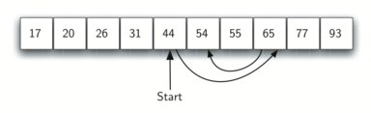
Binary Search
For example, searching for 54 again:

Slide 7
Divide and Conquer
Binary search uses Divide and Conquer!
We divide the problem into smaller pieces, solve the smaller pieces in some way, and then reassemble the whole problem to get the result.

Slide 8
Binary Search Analysis
Each comparison eliminates about half of the remaining items from consideration.
What is the maximum number of comparisons this algorithm will require to check the entire list?

Slide 9
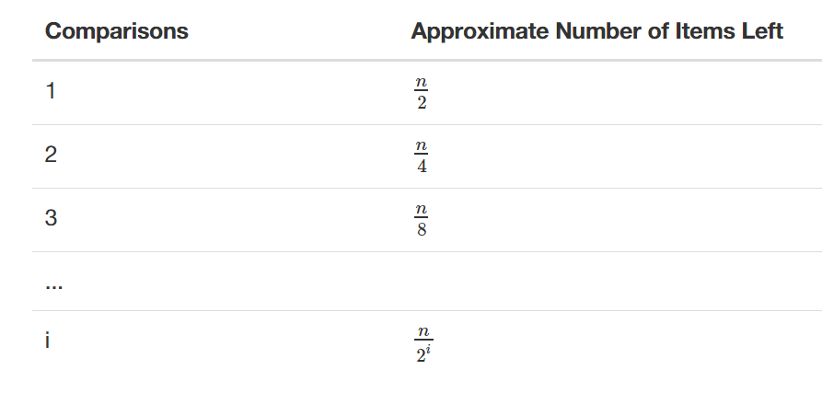
Binary Search Analysis

Slide 10
Binary Search Analysis
Up next, implementing two versions of Binary Search!

